Slide 1

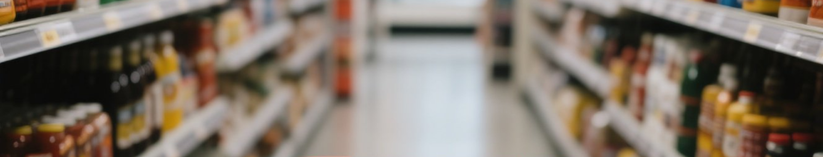


An E-Commerce Company’s Path to Sustainable Growth
Presented by – Souvik Roy

Slide 2


CONTENTS
Introduction
Problem Stakeholder
Key Focus Areas
Key KPIs
Final Dashboard
Daily sales, Weekday Sales
Order Fulfillment, Top Salling Category
Weekday ordered QTD
Return VS Cancellation
Sales by State
Data Analysis Approach
Recommendation
Conclusion
Thank You

Slide 3


Introduction
This project focuses on optimizing the operations of an e-commerce company facing challenges that hinder growth and customer satisfaction. By leveraging data-driven analysis, the project explores key areas such as financial performance, customer behavior, logistics, and product management. The dataset includes order details, fulfillment methods, product categories, quantities, and sales amounts. The goal is to identify trends, calculate key performance indicators (KPIs), and uncover actionable insights. Through this analysis, the company can improve customer experience, reduce operational inefficiencies, and drive sustainable growth in a competitive online retail environment.

Slide 4

Company Background
The e-commerce company is facing multiple
operational challenges that hinder growth and
customer satisfaction.
To address these issues, the company is
leveraging data-driven insights to optimize
operations.

Slide 5

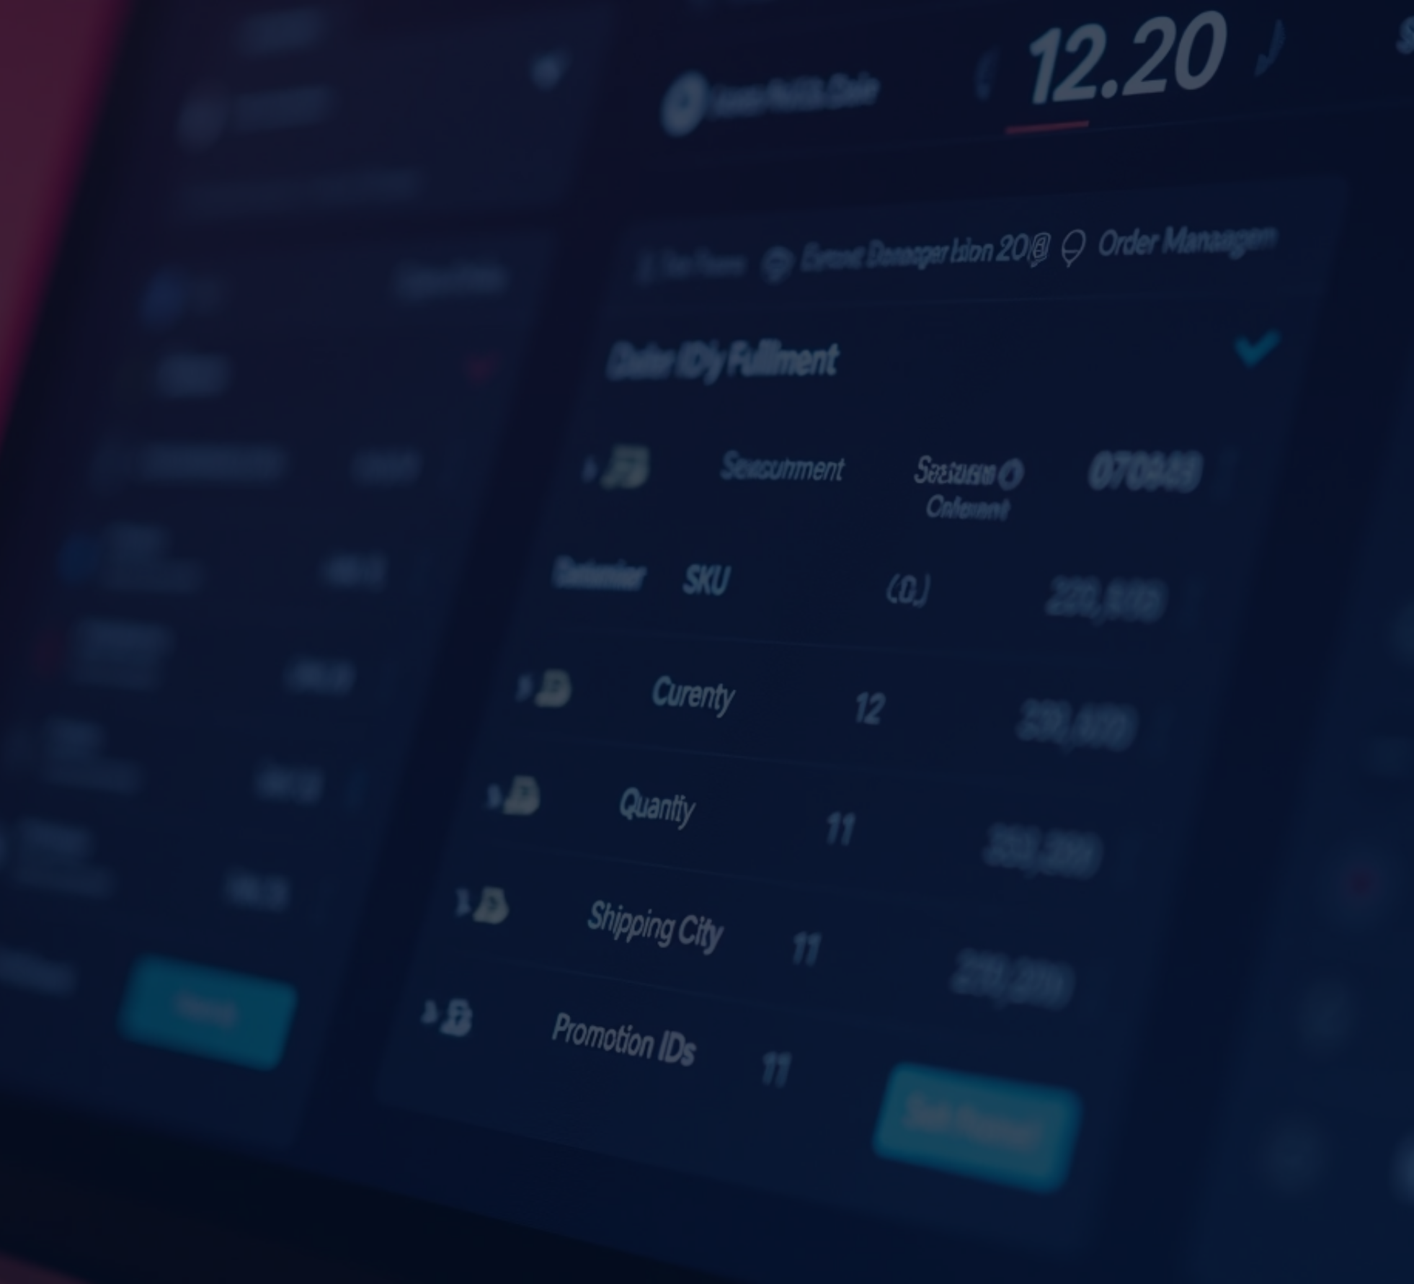

Problem Statement
The objective is to conduct a comprehensive analysis of business operations across five key domains: financial performance, customer behaviour, logistics, product management, and customer satisfaction. This involves tracking revenue growth, identifying sales trends, understanding customer and location-based patterns, optimizing fulfilment processes, improving inventory control, and minimizing returns and cancellations. The goal is to drive data-informed decisions to enhance overall efficiency, profitability, and customer experience.

Slide 6


📈 Key Focus Areas
Financial Performance
Customer Insights
Logistics & Fulfillment
Product Management
Customer Satisfaction & Returns

Slide 7
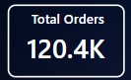
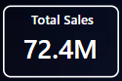
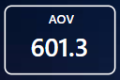
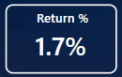
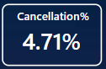
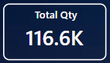
Key KPIs
.

Slide 8
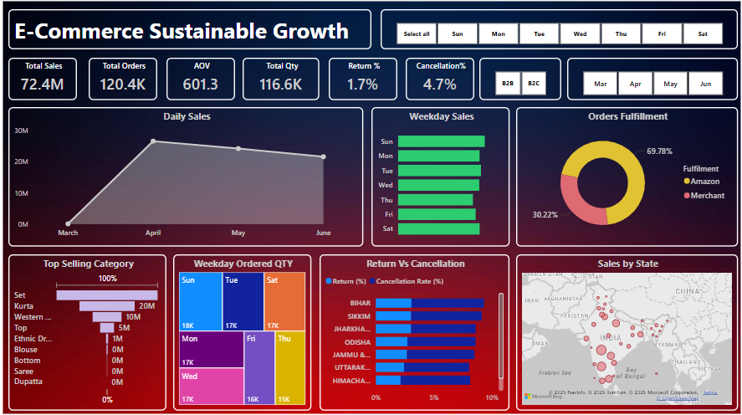
FINAL DASHBOARD

Slide 9

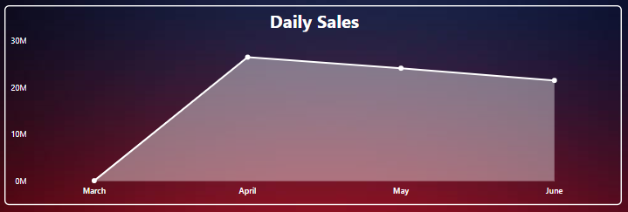
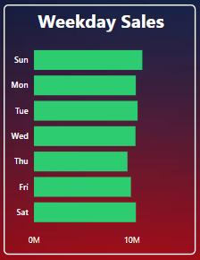
Que: Analyzing total revenue growth over time. Identifying
best-selling products and seasonal sales trends?
Dax: Total_sales = SUM(transformed_data[Sales])
Que: Estimating the Total sales for each day of
the week based on the bar lengths?
Dax:Total_sales = SUM (transformed_data[Sales])

Slide 10

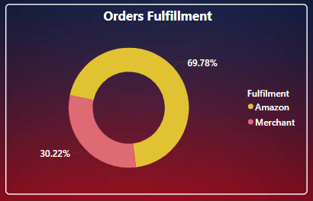
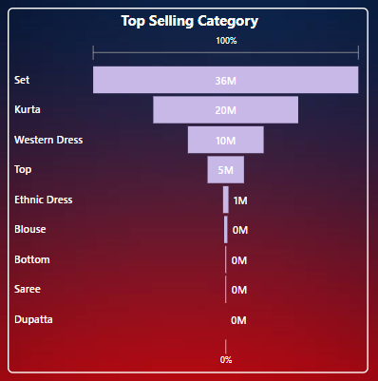
Que: Comparing orders fulfilled by Amazon vs.
Merchant fulfillment?
Dax: Total_sales = SUM(transformed_data[Sales])
Que: Identifying best-selling products and seasonal sales trends?
Dax: Total_orders = DISTINCTCOUNT(transformed_data[Order ID])

Slide 11

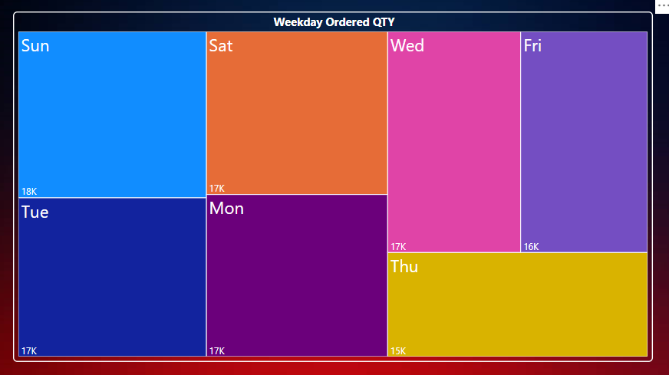


Que: Identifying high-demand product categories?
Dax: Total QTY = CALCULATE(SUM(transformed_data[Qty]),transformed_data[CourierStatus]<>"Cancelled")
Shipping Delays
Order Comparison
Order Processing

Slide 12

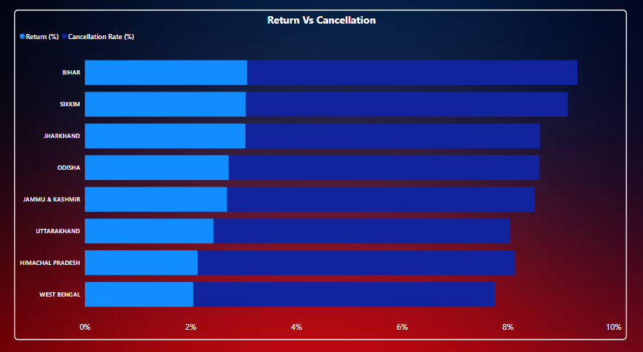
Que: Investigating high return and cancellation rates?
Dax 1: Return(%) = DIVIDE([Returned_orders], DISTINCTCOUNT(transformed_data[OrderID]))
Dax 2:Cancellation Rate (%) = DIVIDE([Cancelled_orders], [Total_orders])

Slide 13
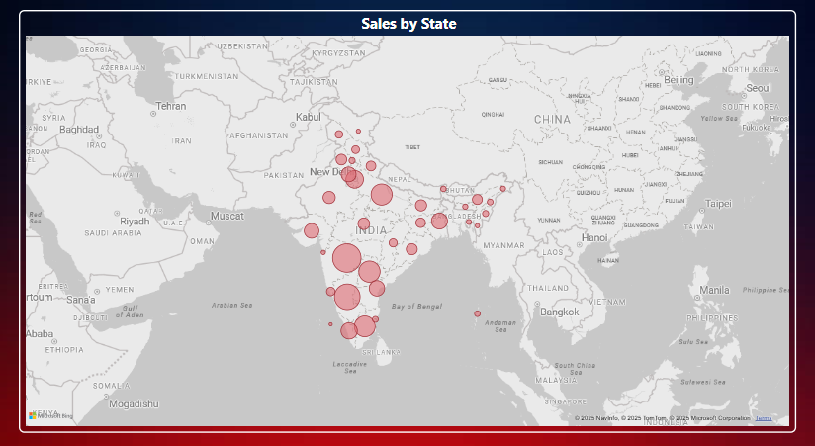


Que: Identifying top-performing locations based on sales volume?
Dax: Total_sales = SUM(transformed_data[Sales])
The e-commerce company is facing multiple operational challenges that hinder growth and customer satisfaction.
To address these issues, the company is leveraging data-driven insights to optimize operations.

Slide 14





Data Analysis Approach
Step 1: Data exploration and understanding.
Step 2: Data cleansing (handling missing values, replacing nulls in the
'Amount' column with the median).
Step 3: In-depth analysis focusing on revenue,
customer behavior, logistics, and returns.
Return Investigation
Quality Enhancement
Customer Experience

Slide 15
RECOMMENDATION
1. Financial Performance
Revenue Growth: Positive growth indicates business scalability, but there's no significant growth throughout the timeline.
Best-Selling Products: Product categories like Set is making almost 50% of the revenue.
Average Order Value (AOV) by State: Strategies like bundling or cross-selling can be implemented to increase AOV as Maharashtra and Karnataka contributing 30% of sales
Recommendation: Set is selling most across all month which is a good sign but there is also a huge gap withing the remaining categories which must be noticed immediately for the increase in sales.
2. Customer Insights
Top Locations: State like Maharashtra and Karnataka is making 30% of the sales.
Cancellation Trends: The cancellation number is making flat rate throughout the sales.
B2B vs B2C: B2C sales is actually makes the complete sales as per the conclusion. but there is a significant gap between the AOV between the respective buyers which should to noticed to increase in overall revenue.
Recommendation: There is a significant gap between the AOV between the B2C and B2B which should be noticed to target the sales campaign for the increase in sales.
3. Logistics & Fulfilment Optimization
Shipping Delays: There are 262 orders that were yet to be picked up which is less in number but it needs proper justification for the reason in delay.
Fulfilment Comparison: Amazon-fulfilled orders show better shipping times and customer satisfaction.
Order Processing: There is a total of 267 order which showed unusual systematic behaviour resulted in delay.
Recommendation: Encourage Amazon fulfilment for faster delivery and standardize merchant operations for consistency as the notable delays are from the merchant’s end.

Slide 16
RECOMMENDATION
4. Product Management & Inventory
High-Demand Categories: Top 4 high demand product categories are Set, kurta, Western Dresses and Top.
Average Ordered Quantity:
Inventory Control: To control the inventory to prevent stockouts or overstocking a 5% extra should be considered.
Recommendation: Implement inventory planning to reorder alerts to ensure stock efficiency.
5. Customer Satisfaction & Returns
High Returns & Cancellations: Certain categories like Footwear and Accessories require quality review.
Problematic Products: A list of problematic products which consists of rate more than 10 % should be noticed to identify the reason of high return, which seems problematic.
Service Policy Improvement: A total of 2259 order has been either returned, rejected, lost, damaged or waiting for pick-up needs to addressed carefully for better service.

Slide 17


🧾 Conclusion
The analysis has uncovered both strengths and areas of improvement across the business. While revenue and high-performing products present growth opportunities, challenges in fulfillment, returns, and customer behavior demand strategic attention. By acting on the above recommendations, the organization can drive operational efficiency, enhance customer satisfaction, and achieve sustainable growth.
Optimize
Operations
Drive
Growth
Monitor
Metrics

Slide 18

Thank You
Contact: souvikroy362@gmail.com
Linkedin: linkedin.com/in/souvik-roy-89964591
Github:

